Slide 1


POLYGON GENERATOR

Slide 2
Team Details
Name SRN Email ID
Name
SRN
Email ID
Name SRN Email ID
Name SRN Email ID
: Sravya Yepuri
: PES1UG19CS502
: sravya.bg@gmail.com
: S Usha Priya
: PES1UG19CS407
: ushapriya525@gmail.com
: S S Priya
: PES1UG19CS404
: sspriya147@gmail.com
: Vridhi Goyal
: PES1UG19CS582
: goyalvridhi@gmail.com
** (ALL OF THE MEMBER ARE FROM RR CAMPUS)
2

Slide 3
Polygon Generator
Spatial data are the data that are connected to a place on Earth.
Points, lines and polygons are used for the spatial data objects representation.
Polygons are used to represent the land masses, islands, and water masses, etc.
Polygon features are two dimensional and therefore can be used to measure the area and perimeter of a geographic feature.
We used Well Known Text (WKT) object, which is a text markup language for
representing vector geometry objects, like polygons.

Slide 4
Implementation
Tech Used: R programming.
Firstly,’randgeo’ package is installed and used to generate random points in WKT format and the polygon is then plotted using the function wkt_polygon.
Each time the count of the number of polygons is varied, the number of vertices for each
polygon is chosen randomly from 10-500, and the coordinates of the vertices so generated is
redirected into a .txt file using file operations.
QGIS
For visualization of the polygons generated a geographic information system application,
QGIS is used.
In the first place a layer (Delimited text layer) is added , giving necessary properties and the
data in the text file generated earlier is provided as input to the sample data.
Viewing that layer would provide conception of the polygons generated in a 2D format.

Slide 5
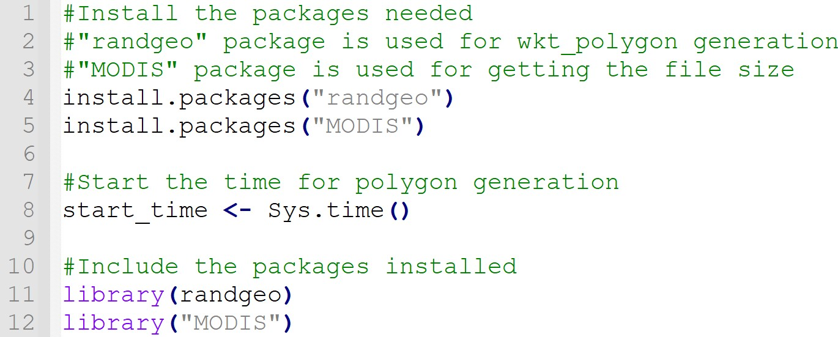
Code Implementation:
The following is the code for the random polygon generation using R
Programming:

Slide 6
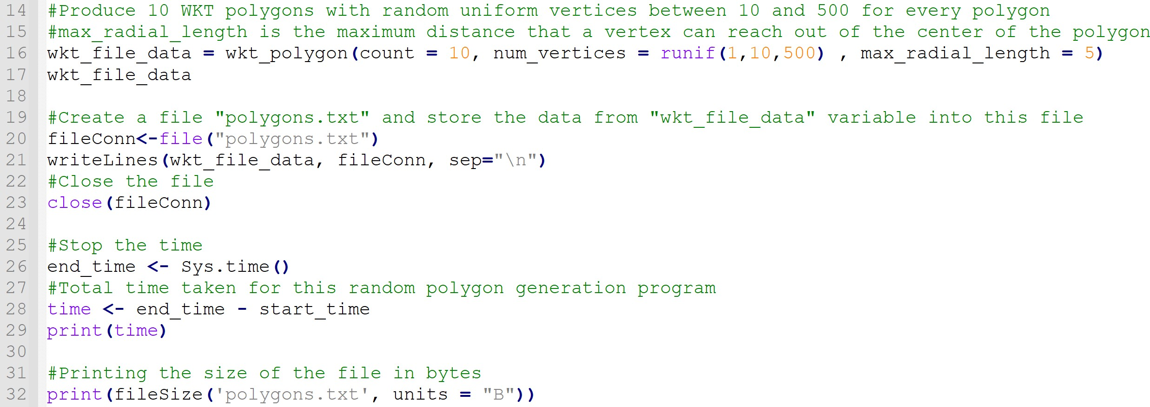

Slide 7
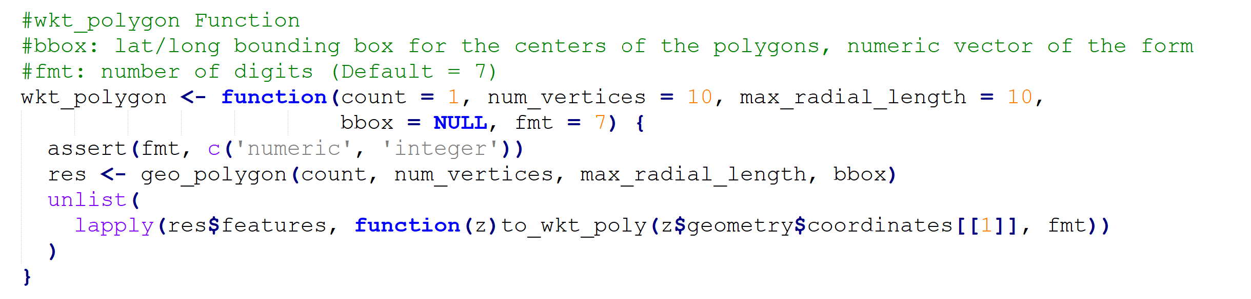

Slide 8
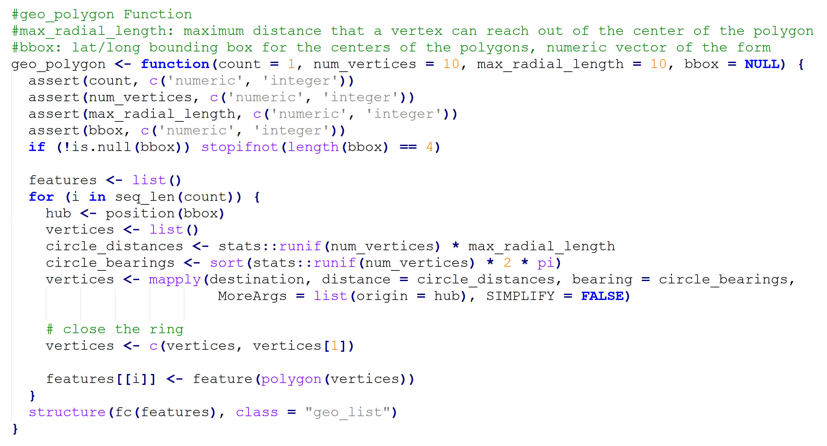

Slide 9
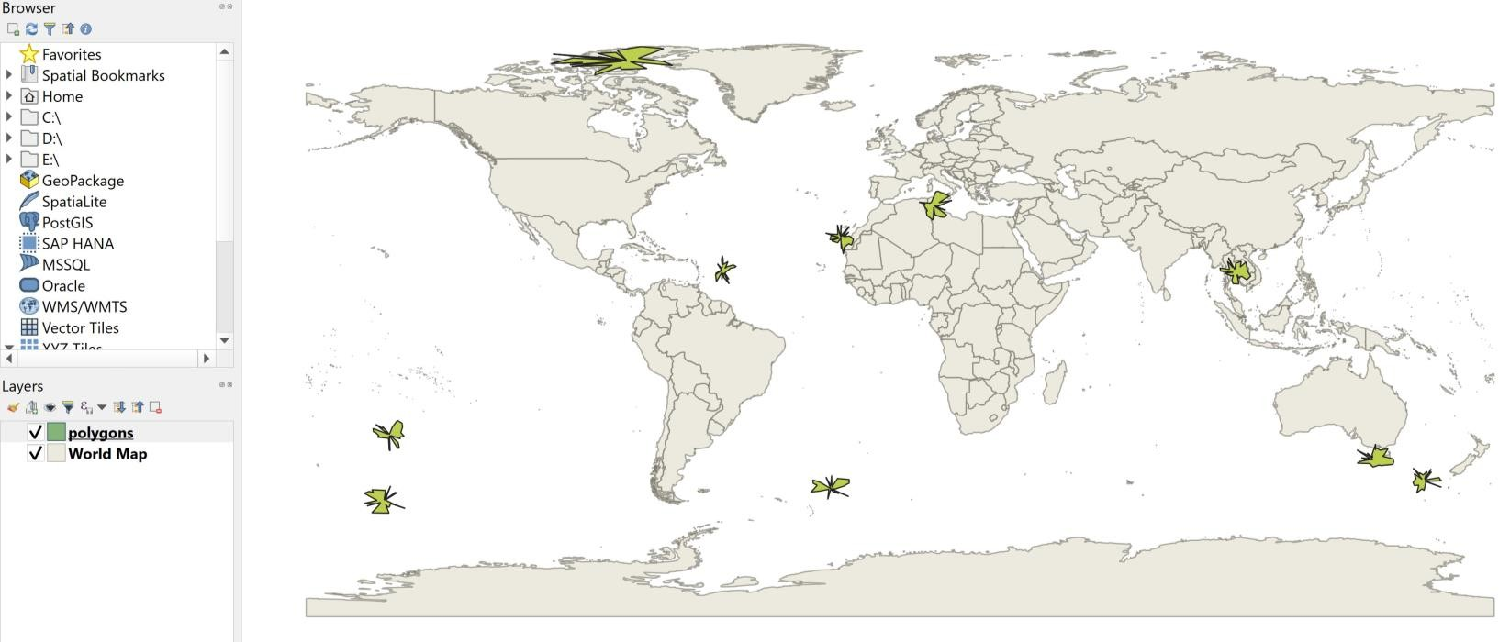
WKT Polygons on QGIS Software:
Ten polygons are shown in green color on the map below :

Slide 10
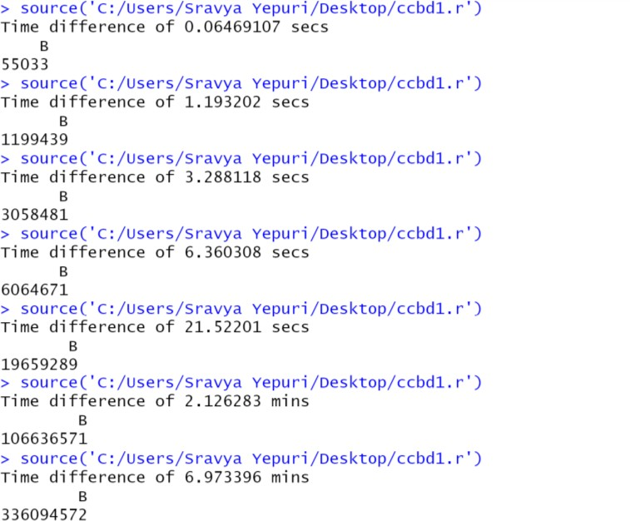
Implementation of Bonus points
generated along with the time taken for it is observed in R code output through the functions
Sys.time() and fileSize() which come under ‘MODIS’ package.
Output of file size and time taken for number of polygons as 10, 100, 500, 1000, 5000,
10000, 50000 is shown on the left.

Slide 11
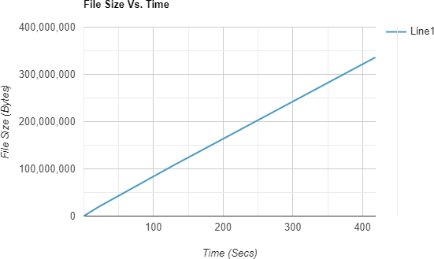
Observation:
o It is spotted that as the size of
the file increases i.e., as and when the number of polygons
to be generated is increased,
the time taken for it to get
generated also increases.

Slide 12
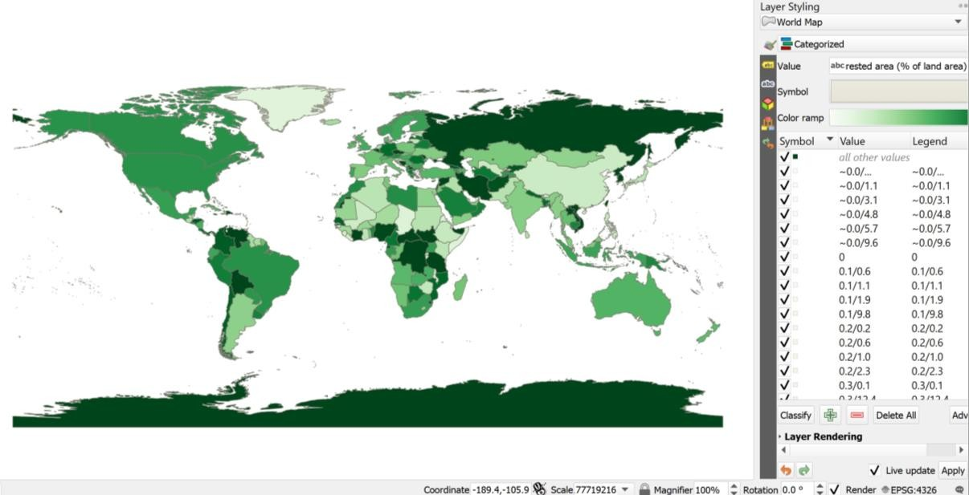
Second Bonus Point:
Percentage distribution can be used for the spatial
objects like water bodies, forests, etc.
We used the QGIS Software
to demonstrate the variations of forest land areas on earth
using a reliable dataset.
This dataset was taken as an
input layer and was linked
with the world map layer in QGIS software to see the result.

Slide 13
THANK YOU!

